Slide 1
Step Up to Reading
Ways to increase reading ability in your classroom

Slide 2
Steps to Reading
Building the steps
Before reading
During reading
After reading

Slide 3
Building the Steps: a framework for reading
California Department of Education, CDE Press, 1430 N Street, Suite 3207, Sacramento, CA 95814.

Slide 4
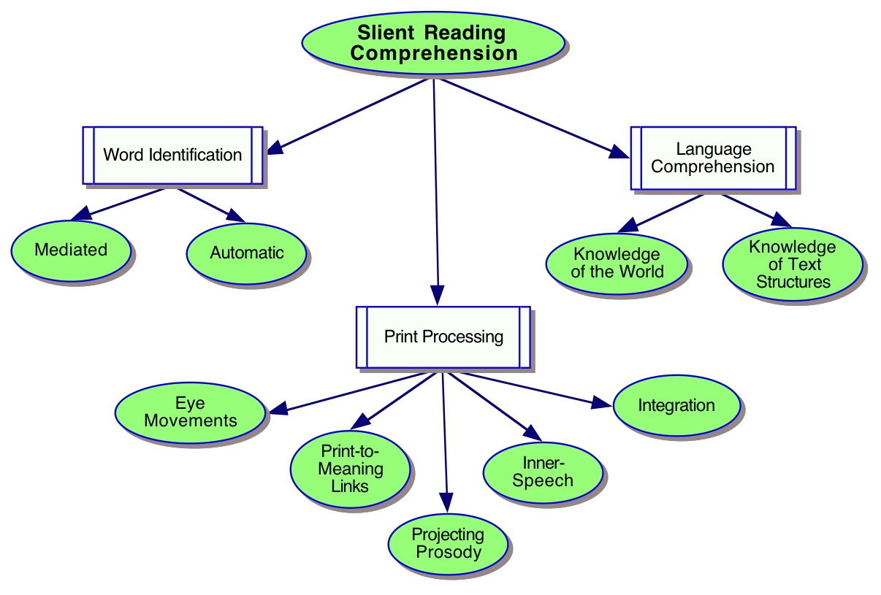
Building the Steps: it’s a big deal

Slide 5
Building the Steps: be honest survey
Where are your students NOW?
What instruments/methods do you use to assess where your students are in reading?
What are your three biggest issues?
Who can help you?
Notes:
Take a moment to answer these questions. Jot them down.

Slide 6
Building the Steps: be honest
Where are your students NOW?
Assessments: Scantron, DORA, MEAP, DRA etc.
Pay Attention! Observe their reading, jot down notes.
What are the three biggest issues?
Short vowels?
Content vocabulary?
Comprehension?
Who can help you?
Peers
Student achievement coaches
Professional development
Title 1 and 31A staff

Slide 7
Building the Steps: whole, rich lessons
Start with the standards. What is the goal?
Use each reading lesson as an opportunity to hit as many aspects of reading as you can using planned activities and teachable moments.
When planning your lessons, consider how to scoop up your lows to meet your middles and launch your highs.
Connect your writing lessons to your reading lessons. Reading and writing go together, include social studies and science material when appropriate.

Slide 8
Before reading: word recognition
Connect word study to what you are reading in class!
Explicit instruction of Phonics (F.A.S.T.)
Word sorts: blends, word families, digraphs, long/short vowels, prefixes, suffixes, comparative, superlative, verb inflections, derived forms, compound words
Reinforce sight words: draw, trace, write sentences, find in magazines, make a spelling dictionary, write in special script, flashcards
Make words: word families, digraphs, long/short vowels, prefixes, suffixes, comparative, superlative, verb inflections, derived forms, compound words

Slide 9
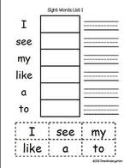
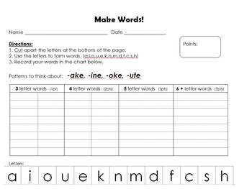
Before reading
Sort Words
Sight Words
Make Words

Slide 10
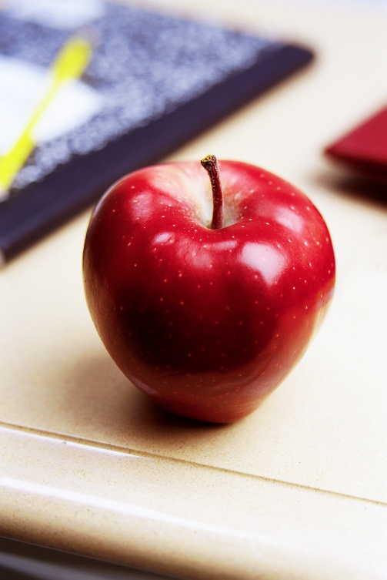
Before reading: predict
Predict which words students won’t decode easily; pull them out, sounds them out
Ex.(shark) s-h makes shhhh…, a-r says ar like a pirate, k says k
Predict which parts of the story will need a think-aloud
Ex. Here the author writes (blah, blah blah,) she’s inferring, or she means, (blah, blah, blah).
Predict which words students won’t understand but will see again and again(no more than 3-5); pull them out, put them on an index card, discuss them.
Ex. Reluctant- means he’s not sure he wants to…

Slide 11
Before reading: prepare
Prepare your students to read:
State reading purpose:
Ex. We are reading to learn about bugs. We are reading this story for enjoyment.
Think aloud your pre-reading habits
Ex. This looks like a fiction story. I have read books by this author before. How many pages is it?
Make the foreign familiar
Ex. what does this remind you of, have you ever experienced this, what do you think it will be about?, let’s look at a picture, etc.

Slide 12
During reading: prepare
“Today we’re going to read a book about Egypt! Does anyone know anything about Egypt?”
(Write this down)
“Good, let’s find out where Egypt is in the world.”
…

Slide 13
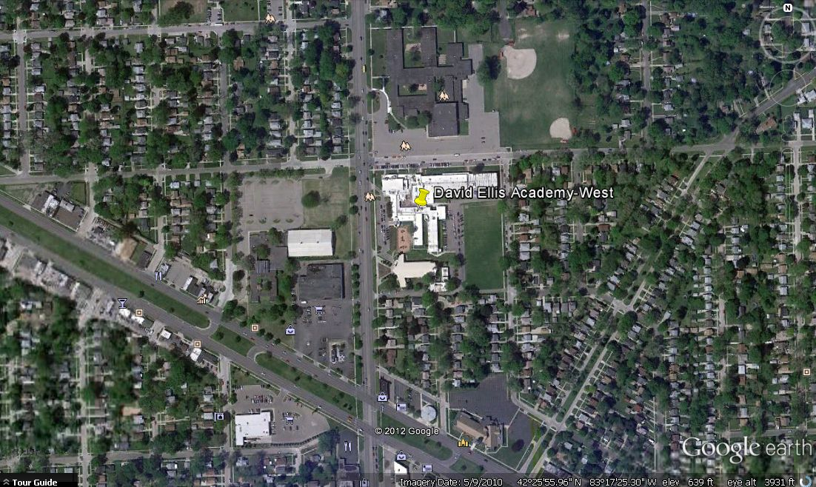

Slide 14
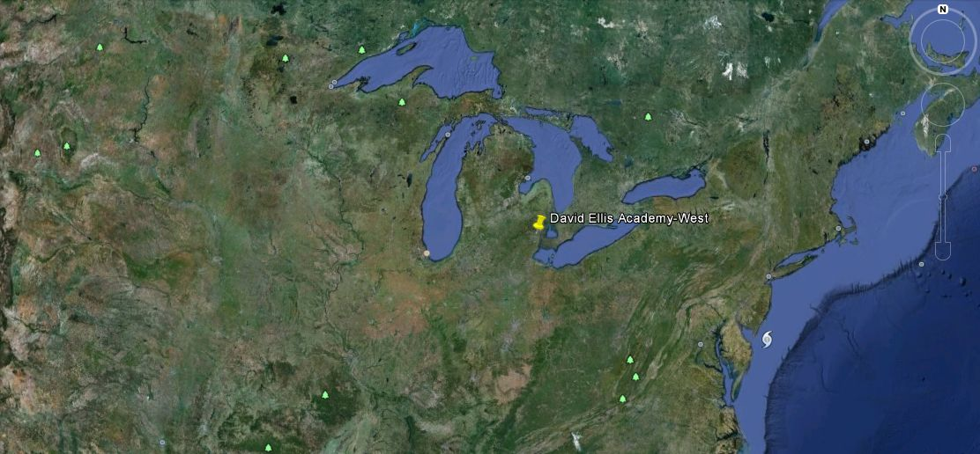

Slide 16
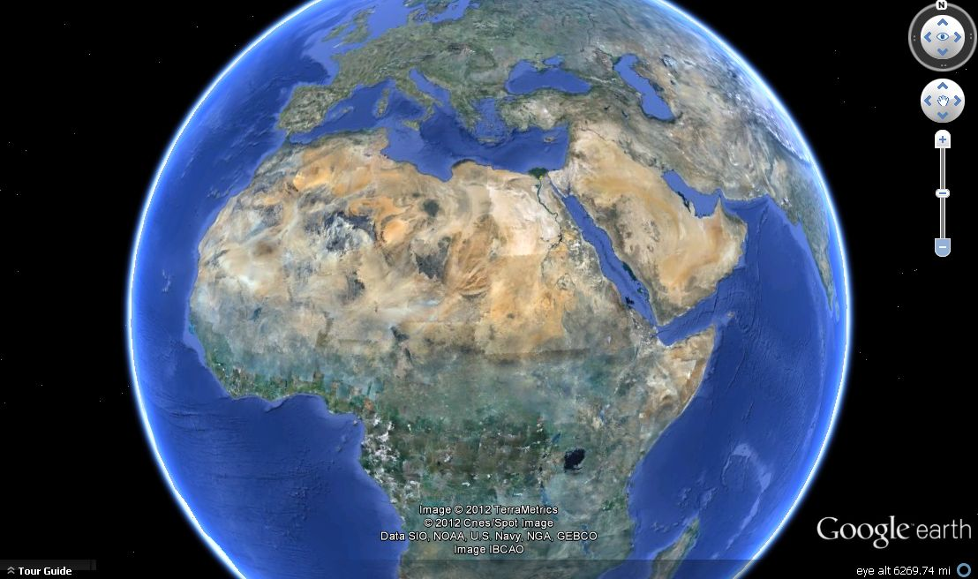

Slide 17
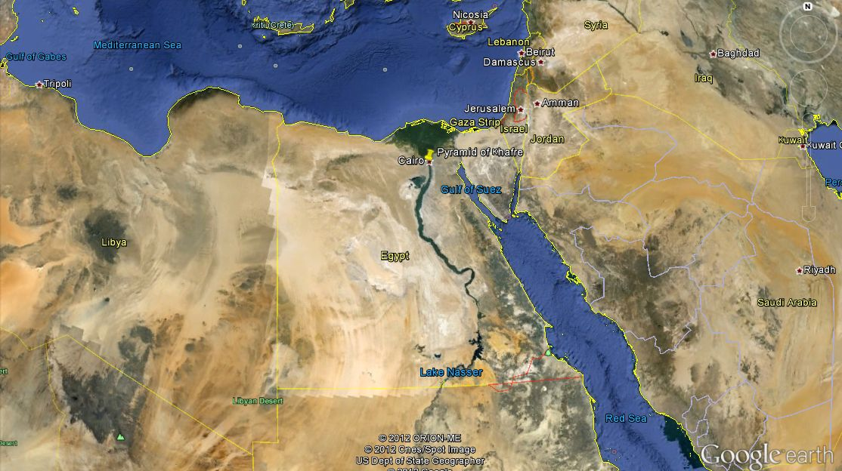

Slide 18
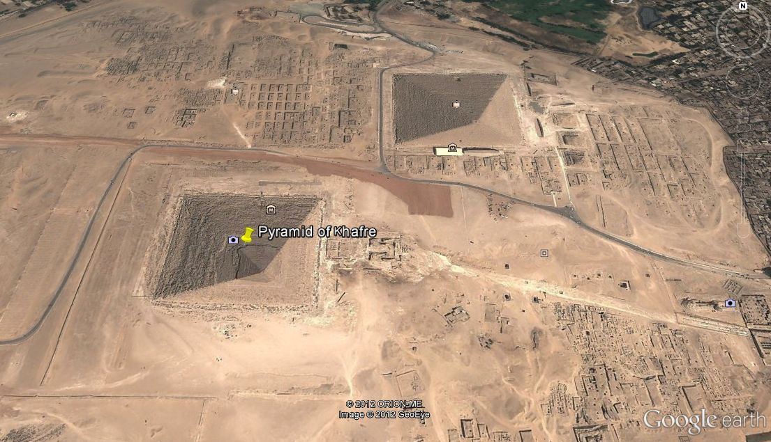

Slide 19
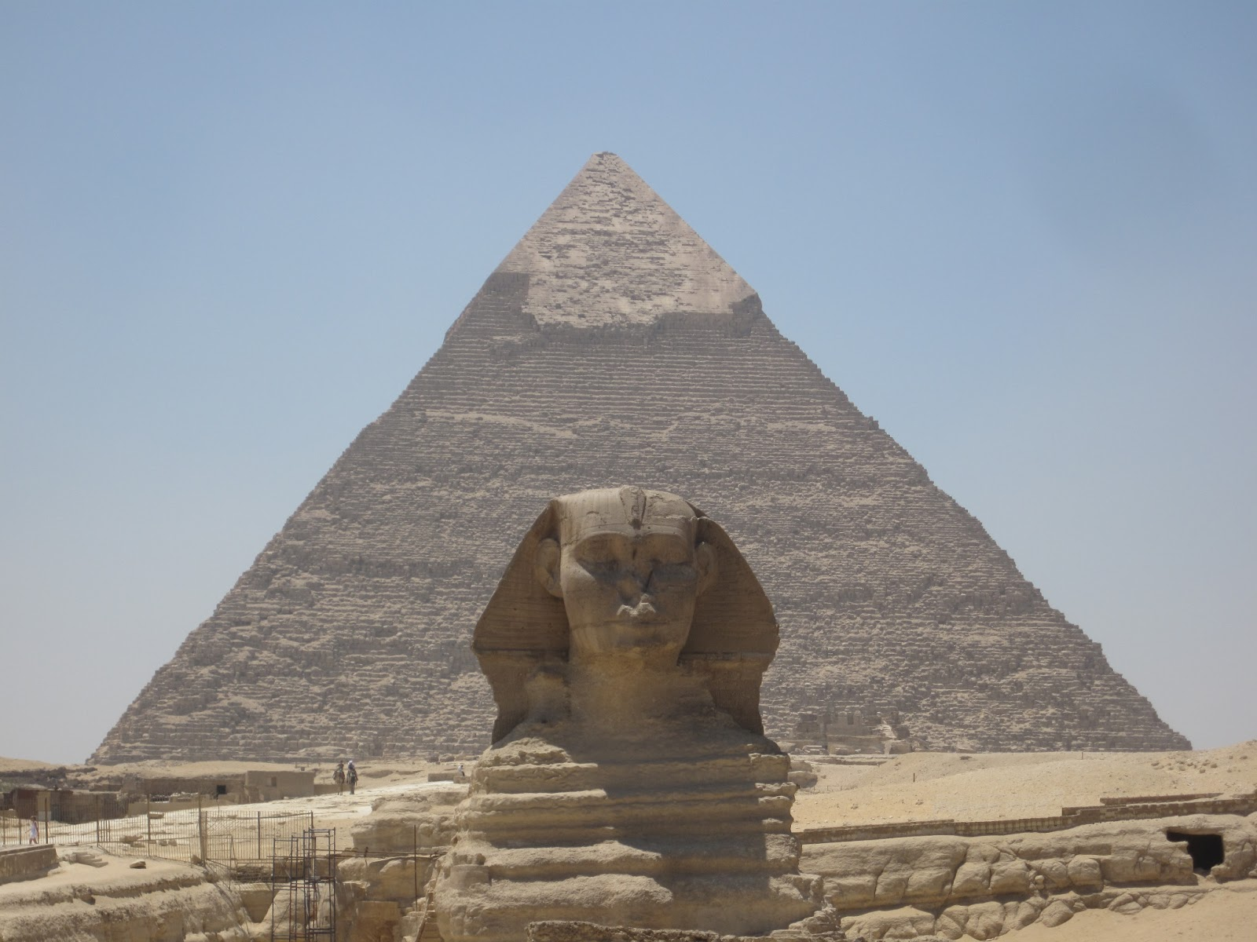

Slide 20
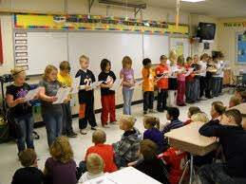
During reading: choral and repeated readings
Choral readings provide built-in support for students who are weak in reading or afraid to read aloud.
Students practice reading fluently.
Students practice and pick up sight words.
Students feel more self-confident.
Students succeed in reading.

Slide 21
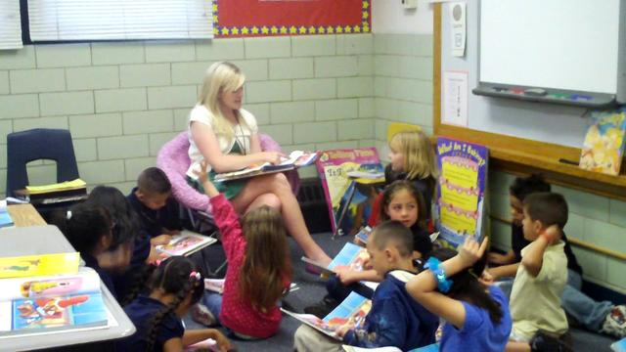
During reading: choral and repeated readings
Step 1: Read the text aloud. Have students point to the words as you read them. Monitor students. Pair up highs with lows to assist.
Step 2: Echo. You read. They echo. Break naturally. They still point.
Ex. There was an old lady/ who lived in a shoe
Step 3: All together. They read with you aloud. Pointing.
Step 4: Choral. They take turns with a partner. (can be by sentence or by page)
Step 5: Students read silently by themselves.

Slide 22
During Reading: think aloud
Predicting- I bet they’ll find the treasure.
Explicit questions- Why does Peter need the money?
Implicit questions- What might happen if they don’t find the treasure?
Word meaning- a compass is an instrument for finding directions
Connections- If I found a treasure I’d…
Probe students for specifics -How much is a lot of money?

Slide 23
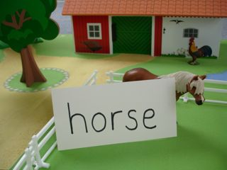
During independent reading: word recognition help
Ask what makes sense
Ask if there is a part of the word that they know
Suggest putting clues together to make a word
Model and illustrate
Ex. stone s-t makes st, what other words say st? Silent e makes the vowel say it’s own name, what vowel is this?

Slide 24
After reading: WRITE!
Students should write for at least 40 minutes a day, 4 days a week (Graves, 1994)
Discuss- prewriting: brainstorming, organizing ideas, paraphrase whole class/small group
Elaborate: story mapping, alternate endings, comparisons, connections, descriptions
Clarify: summarize, reflect, explain, investigate, illustrate
Develop skills: vocabulary building, deciding, creating, inventing,

Slide 25
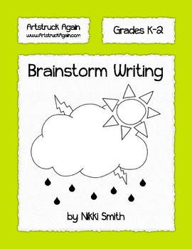
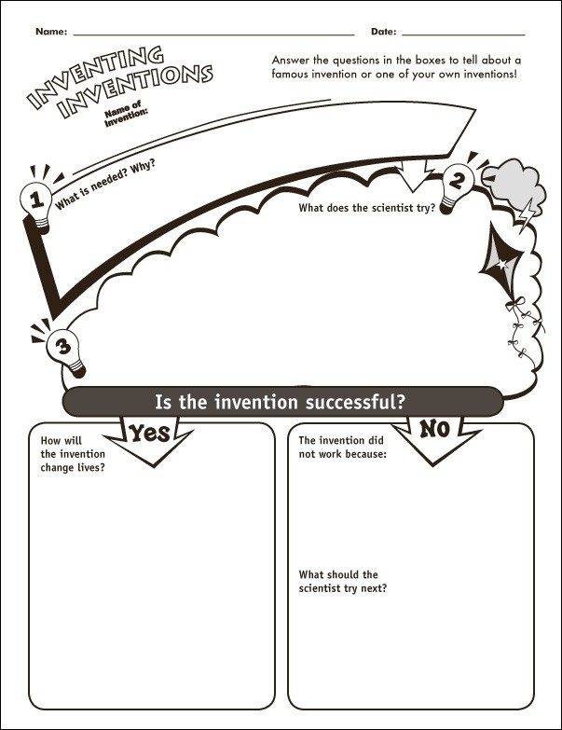
Brainstorm
Illustrate
Invent

Slide 26
After reading: WRITE!
Traditional and Non-traditional Writing Forms
Traditional : autobiographies, poems, mysteries, fables, stories, personal narratives, invitations, book reports, reviews, news stories, folktales, journals, plays, letters, essays, skits, interviews, books, biographies, reports, myths, fairy tales, tall tales, speeches
Non-traditional: text messages, emails, blogs, tweets, status updates, bumper stickers, advertisements, jokes, cartoons, obituaries, greeting cards, raps, menus, song lyrics, proverbs, riddles, editorials, recipes, maps, comic strips, posters, job postings, résumés, thank-you notes

Slide 27
Before/During/After reading activities
Open the PowerPoint Presentation in Slide Show. Roll over the strategy you would like to see. Click it. Download and print.
These strategies are provided by Raymond C. Jones from Reading Quest.
You should use some of these with content areas.
ABC brainstorm carousel clock buddies column notes comparison-contrast CD map graphic organizers history frames inquiry chart K - W - L opinion-proof power thinking problem-solution QARs questioning the author pattern puzzles RAFT papers reciprocal teaching underlining semantic feature analysis story maps summarizing thesis-proof think-pair-share 3-minute pause 3 - 2 - 1 venn diagrams word maps

Slide 28
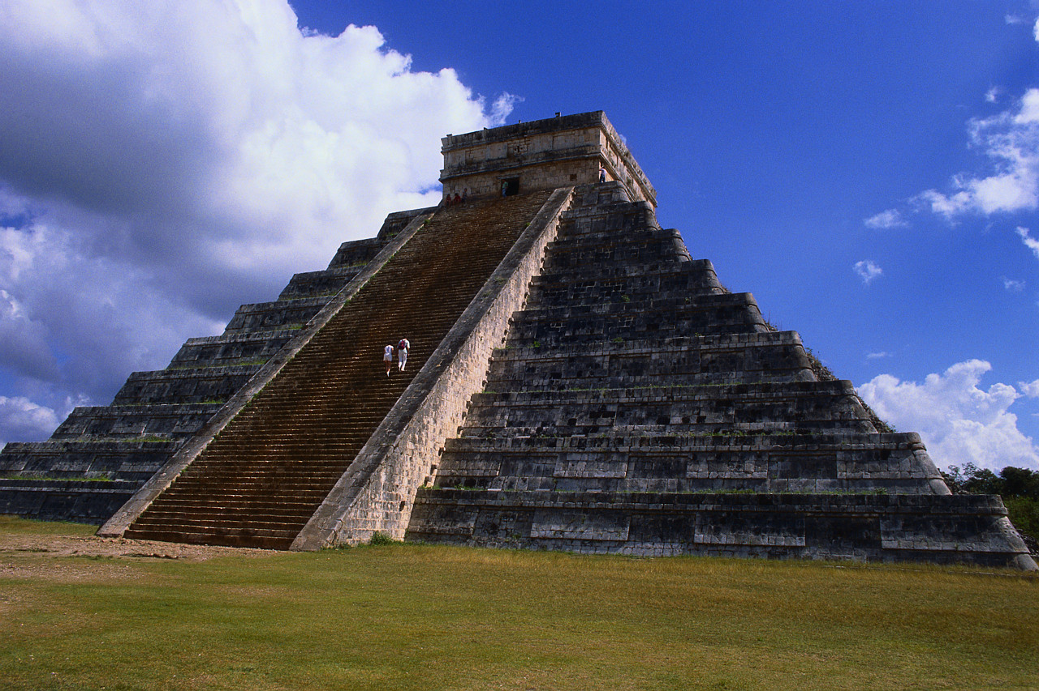
Students can reach the top, but you have to build the steps.

